Slide 1
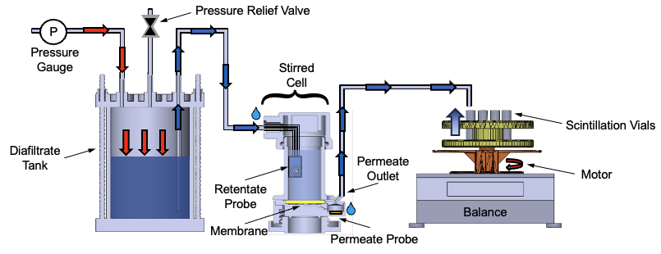
Plan for a Digital Twin Testbed
From Parameter Estimation to Adaptive Experiment Design in Diafiltration Systems
Digital Model (Current Setup)
Keshav Kasturi Rangan
Group Meeting
April 2, 2026

Slide 2


Membrane Characterization using a Digital Model
Prior
Knowledge
Experimental Data
Parameter Estimation
Sensitivity & Uncertainty Analysis
Uncertainty Acceptable?
Model with Quantified Uncertainty
Yes
Model(s)
No
Model-Based Design of Experiments
• Dotted lines ⇢ manual data transmission
• Solid lines → automatic data transmission
Notes:
“Membrane characterization can be formulated as a dynamic inverse problem, where we estimate transport parameters from time-resolved experimental data.”
“However, these parameters are often poorly identifiable due to strong correlations, which leads to an ill-conditioned inference problem.”
“To address this, we adopt a closed-loop uncertainty quantification framework.”
👉 (point to diagram)
“We estimate parameters using weighted least squares, quantify uncertainty through sensitivities and the Fisher Information Matrix, and then design new experiments to improve identifiability.”
“This creates a sequential learning loop.”
Final line (slow down):
“Our goal is to reshape the information geometry of the problem so that the parameters become identifiable.”

Slide 3
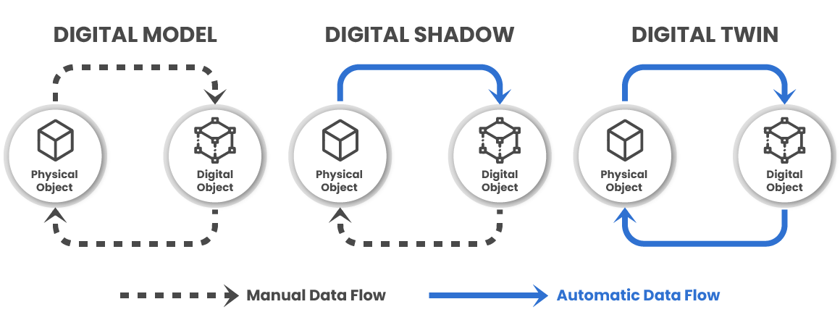
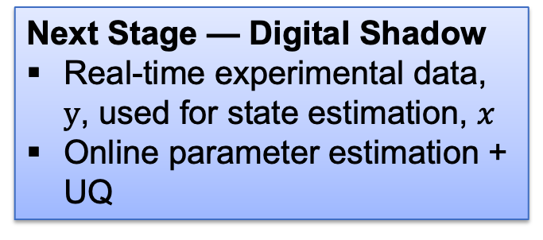
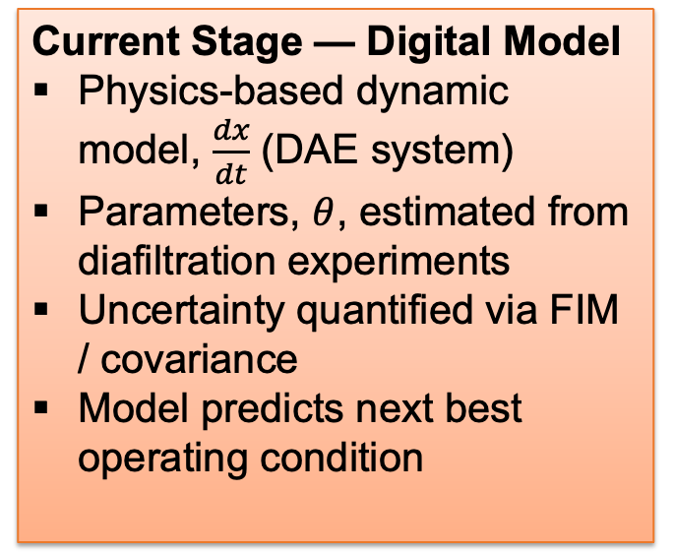
From Dynamic Inference to Uncertainty-Aware Digital Twins
Current Stage — Digital Model
Physics-based dynamic model, $\frac{dx}{dt}$ (DAE system)
Parameters, $θ$, estimated from diafiltration experiments
Uncertainty quantified via FIM / covariance
Model predicts next best operating condition
Next Stage — Digital Shadow
Real-time experimental data, $y$, used for state estimation, $x$
Online parameter estimation + UQ
Final Stage — Self-Driving Lab
MBDoE selects optimal next experiment
Inner loop → set-point tracking
Close the loop: experiment → estimate → UQ → MBDoE → experiment
This transforms parameter estimation and uncertainty quantification into adaptive experimental learning
Figure adapted from Kritzinger et al. (2018), “Digital Twin in Manufacturing: A Categorical Literature Review and Classification,” IFAC‑PapersOnLine.
Notes:
This is no longer a static workflow — it is a feedback system

Slide 4
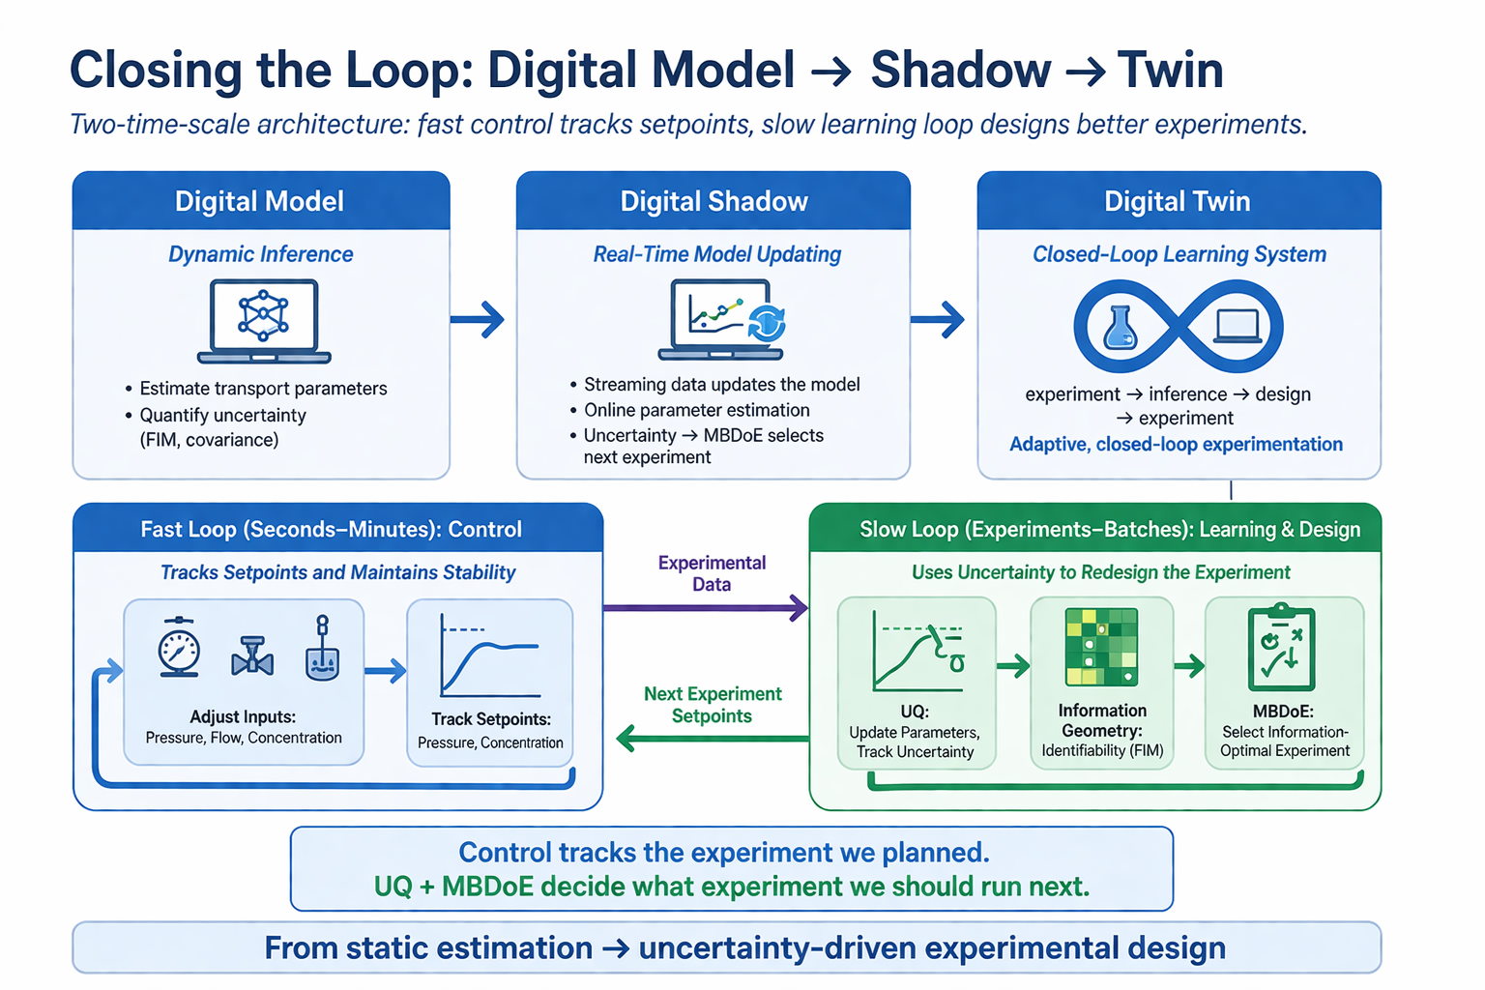
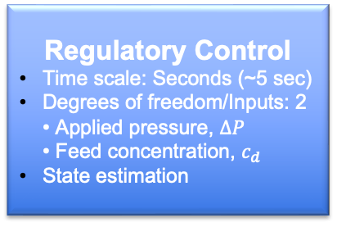
Supervisory Control
Time scale: Hours (~1 hr)
Uncertainty quantification
Model selection based on MBDoE
n-degrees of freedom • Start-up mode • Pressure schedule • Termination condition
Medium Loop (minutes)
Real-time Monitoring
Time scale: Minutes (~5 min)
Parameter estimation
Fault detection
Regulatory Control
Time scale: Seconds (~5 sec)
Degrees of freedom/Inputs: 2 • Applied pressure, $ΔP$ • Feed concentration, $c_{d}$
State estimation
Notes:
“Even with the same model, different experiments can produce very different information about the parameters.”
(point to filtration)
“Filtration operates over a relatively narrow concentration range.”
(point to diafiltration)
“In contrast, diafiltration sweeps the system across a much broader range of operating conditions.”
(pause)
“The question is: which experiment actually makes the parameters identifiable?”
Information is not a property of the model — it is a property of the experiment

Slide 5
Backup Files
📎

Slide 6
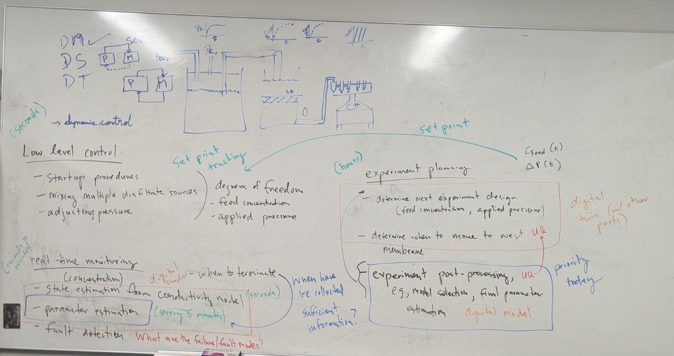

Slide 7
Notes:
“Even with the same model, different experiments can produce very different information about the parameters.”
(point to filtration)
“Filtration operates over a relatively narrow concentration range.”
(point to diafiltration)
“In contrast, diafiltration sweeps the system across a much broader range of operating conditions.”
(pause)
“The question is: which experiment actually makes the parameters identifiable?”
Information is not a property of the model — it is a property of the experiment

Slide 8
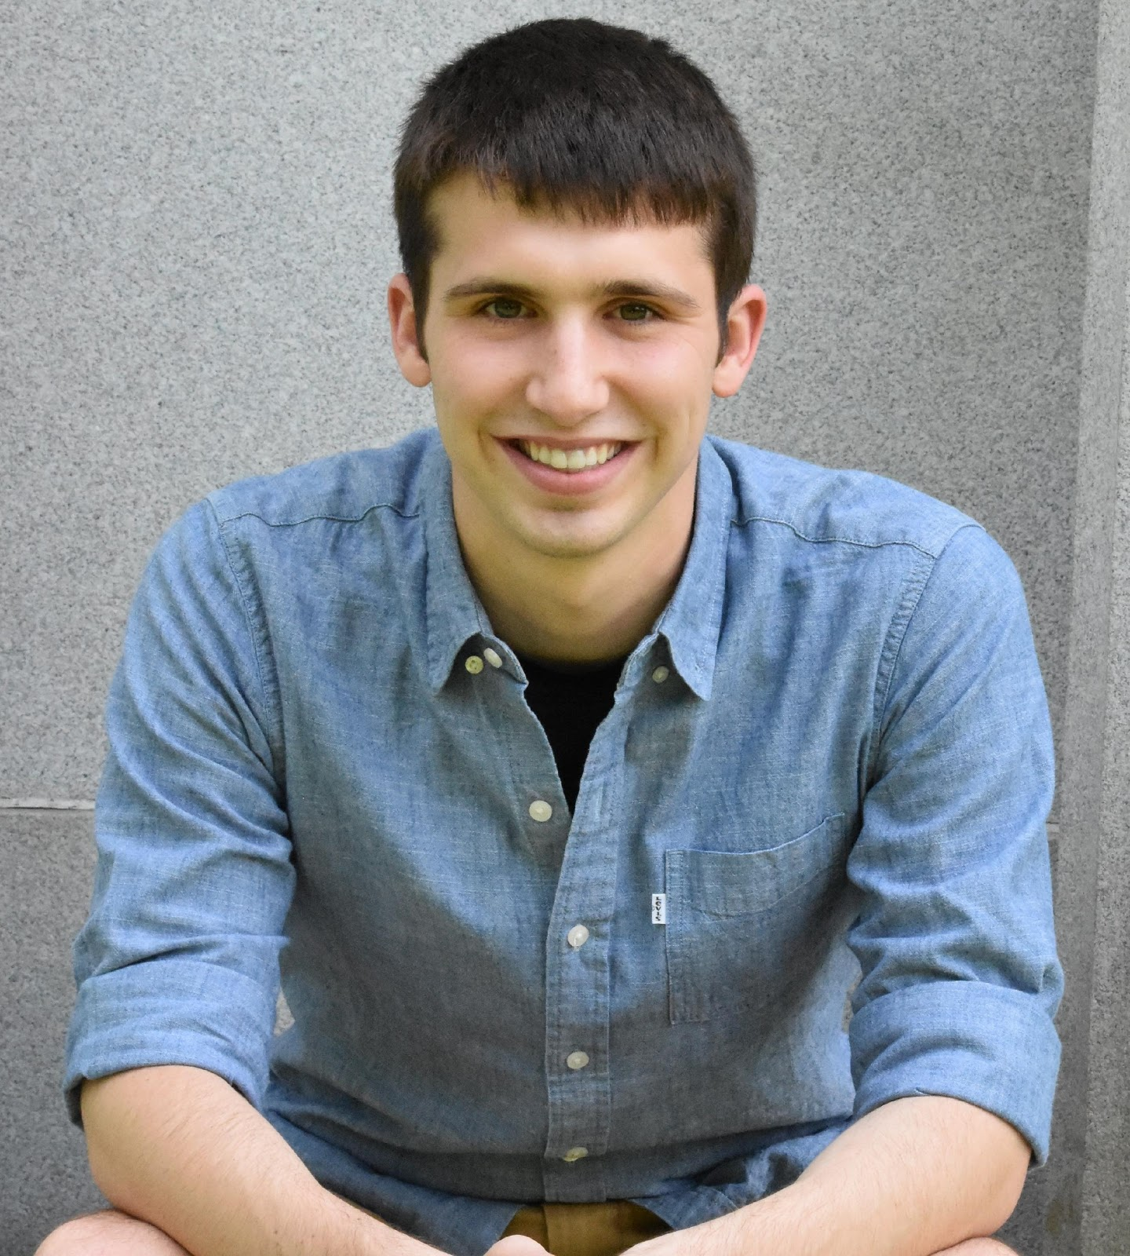
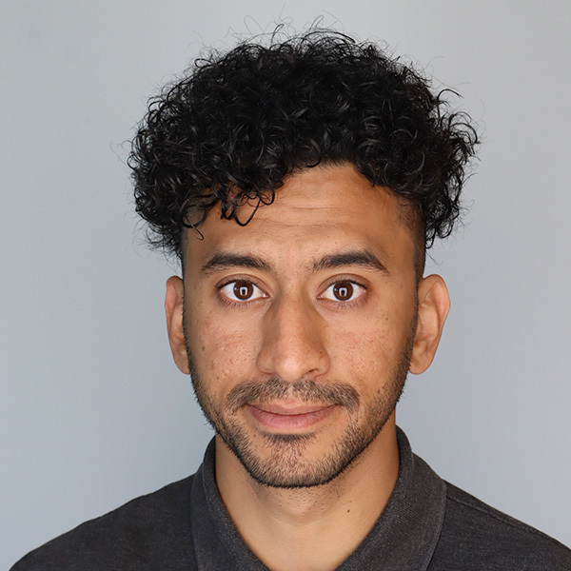
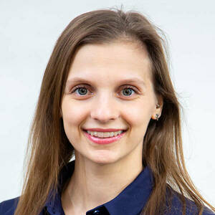
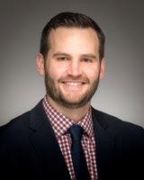
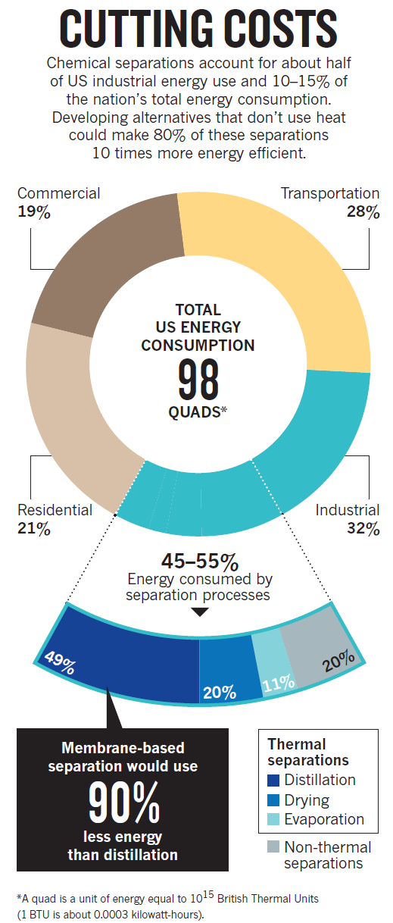
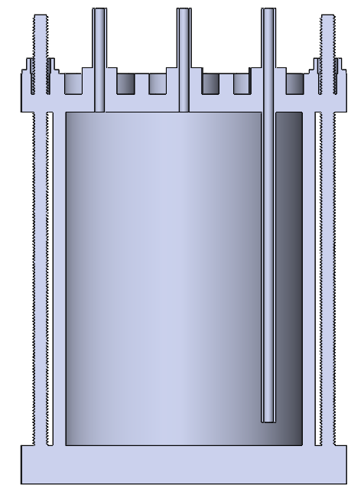
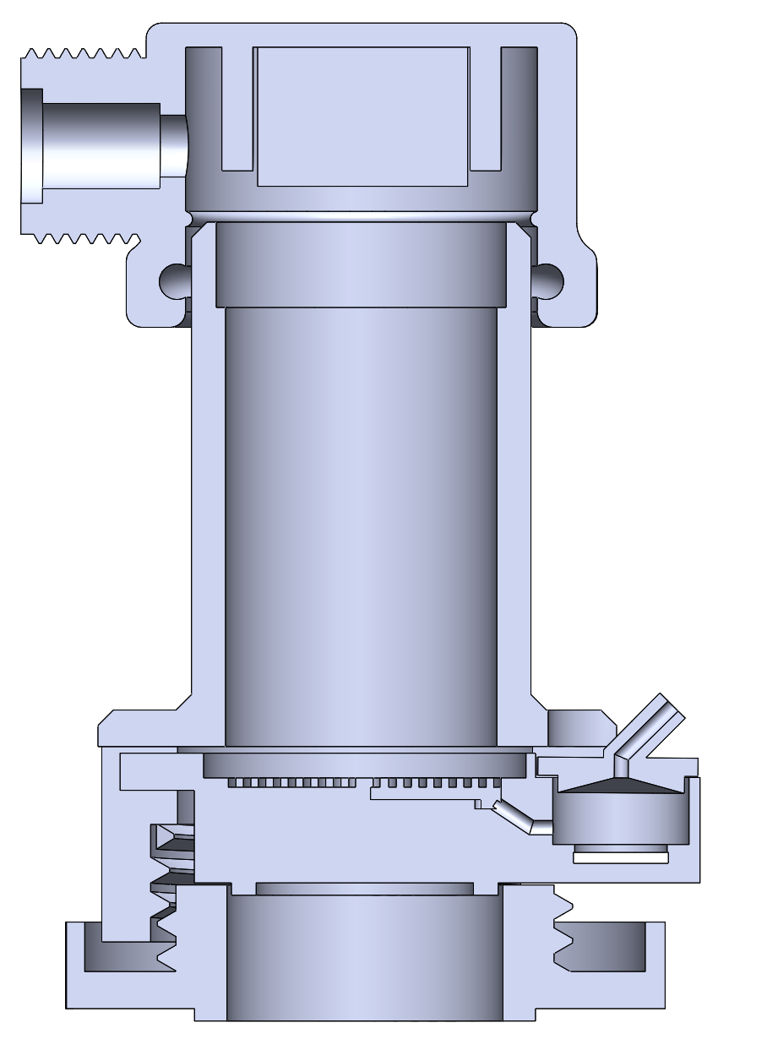
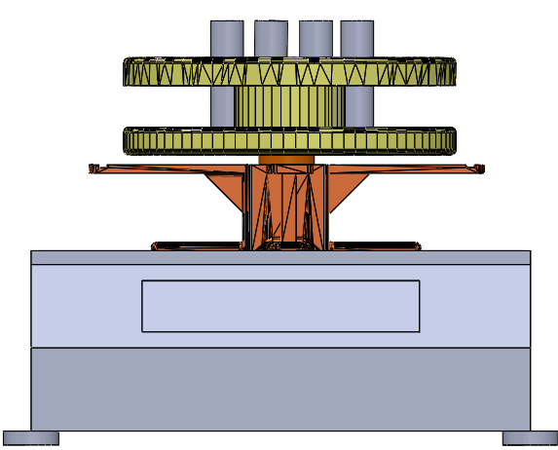
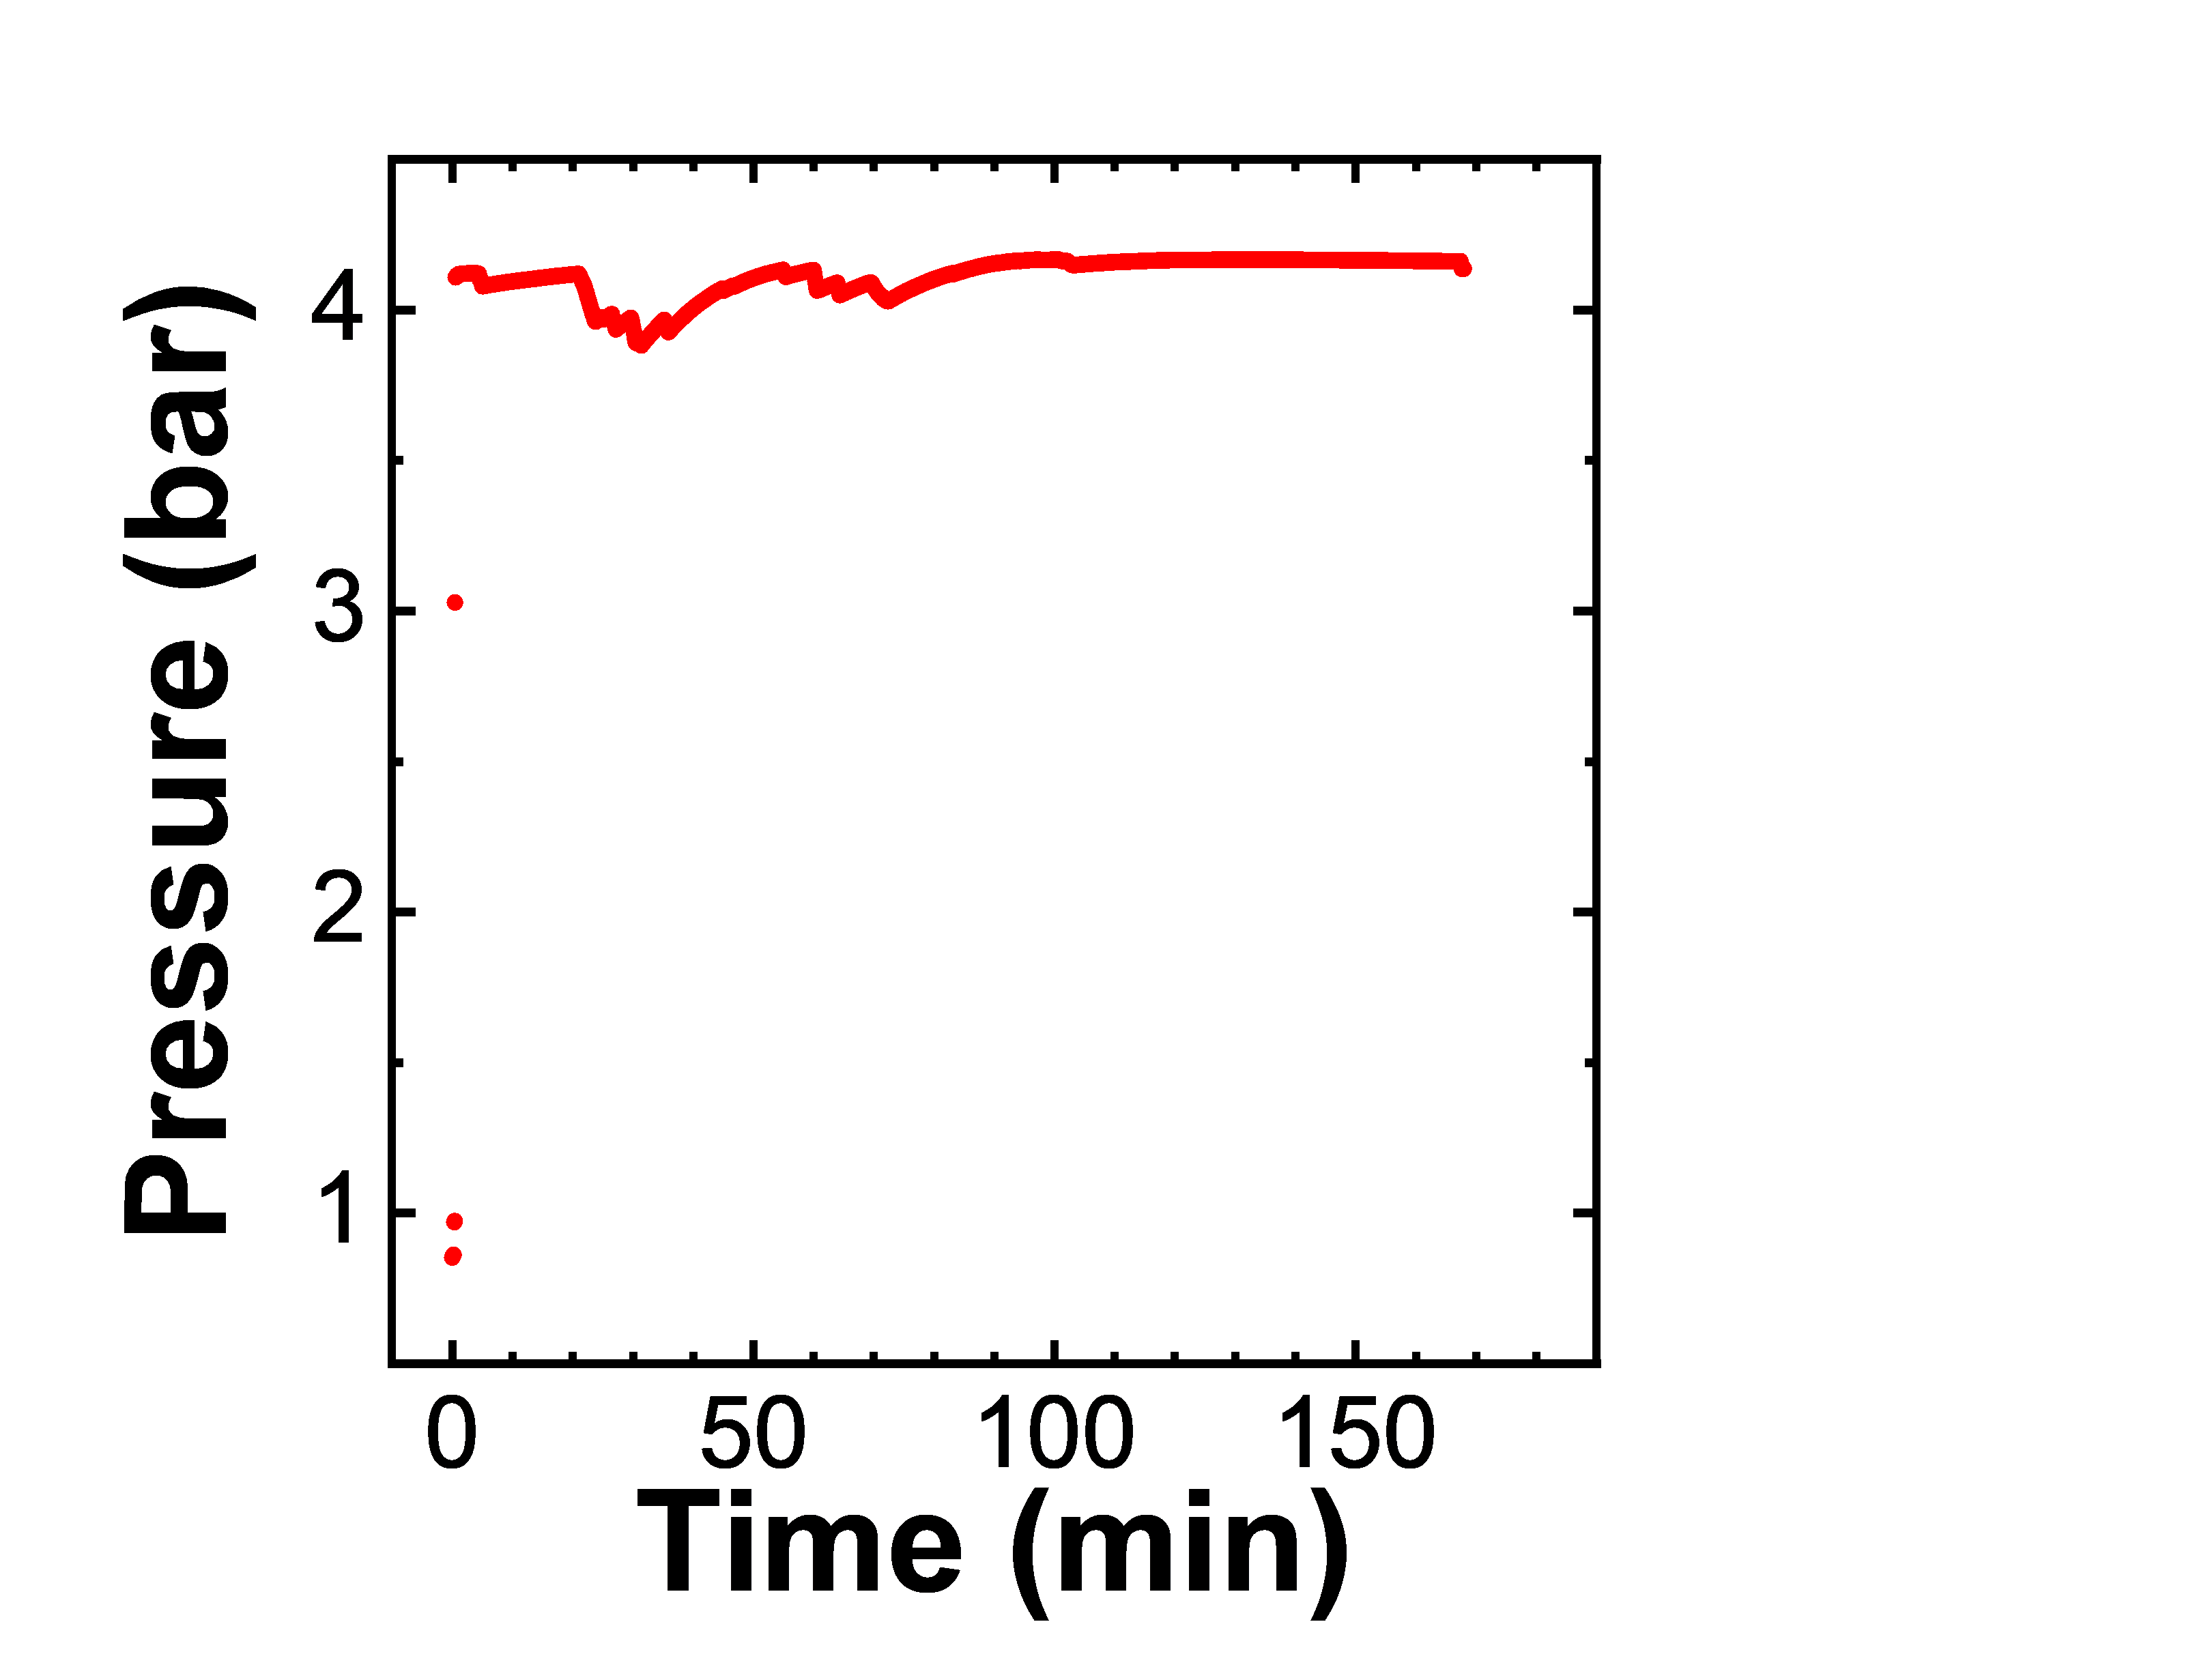
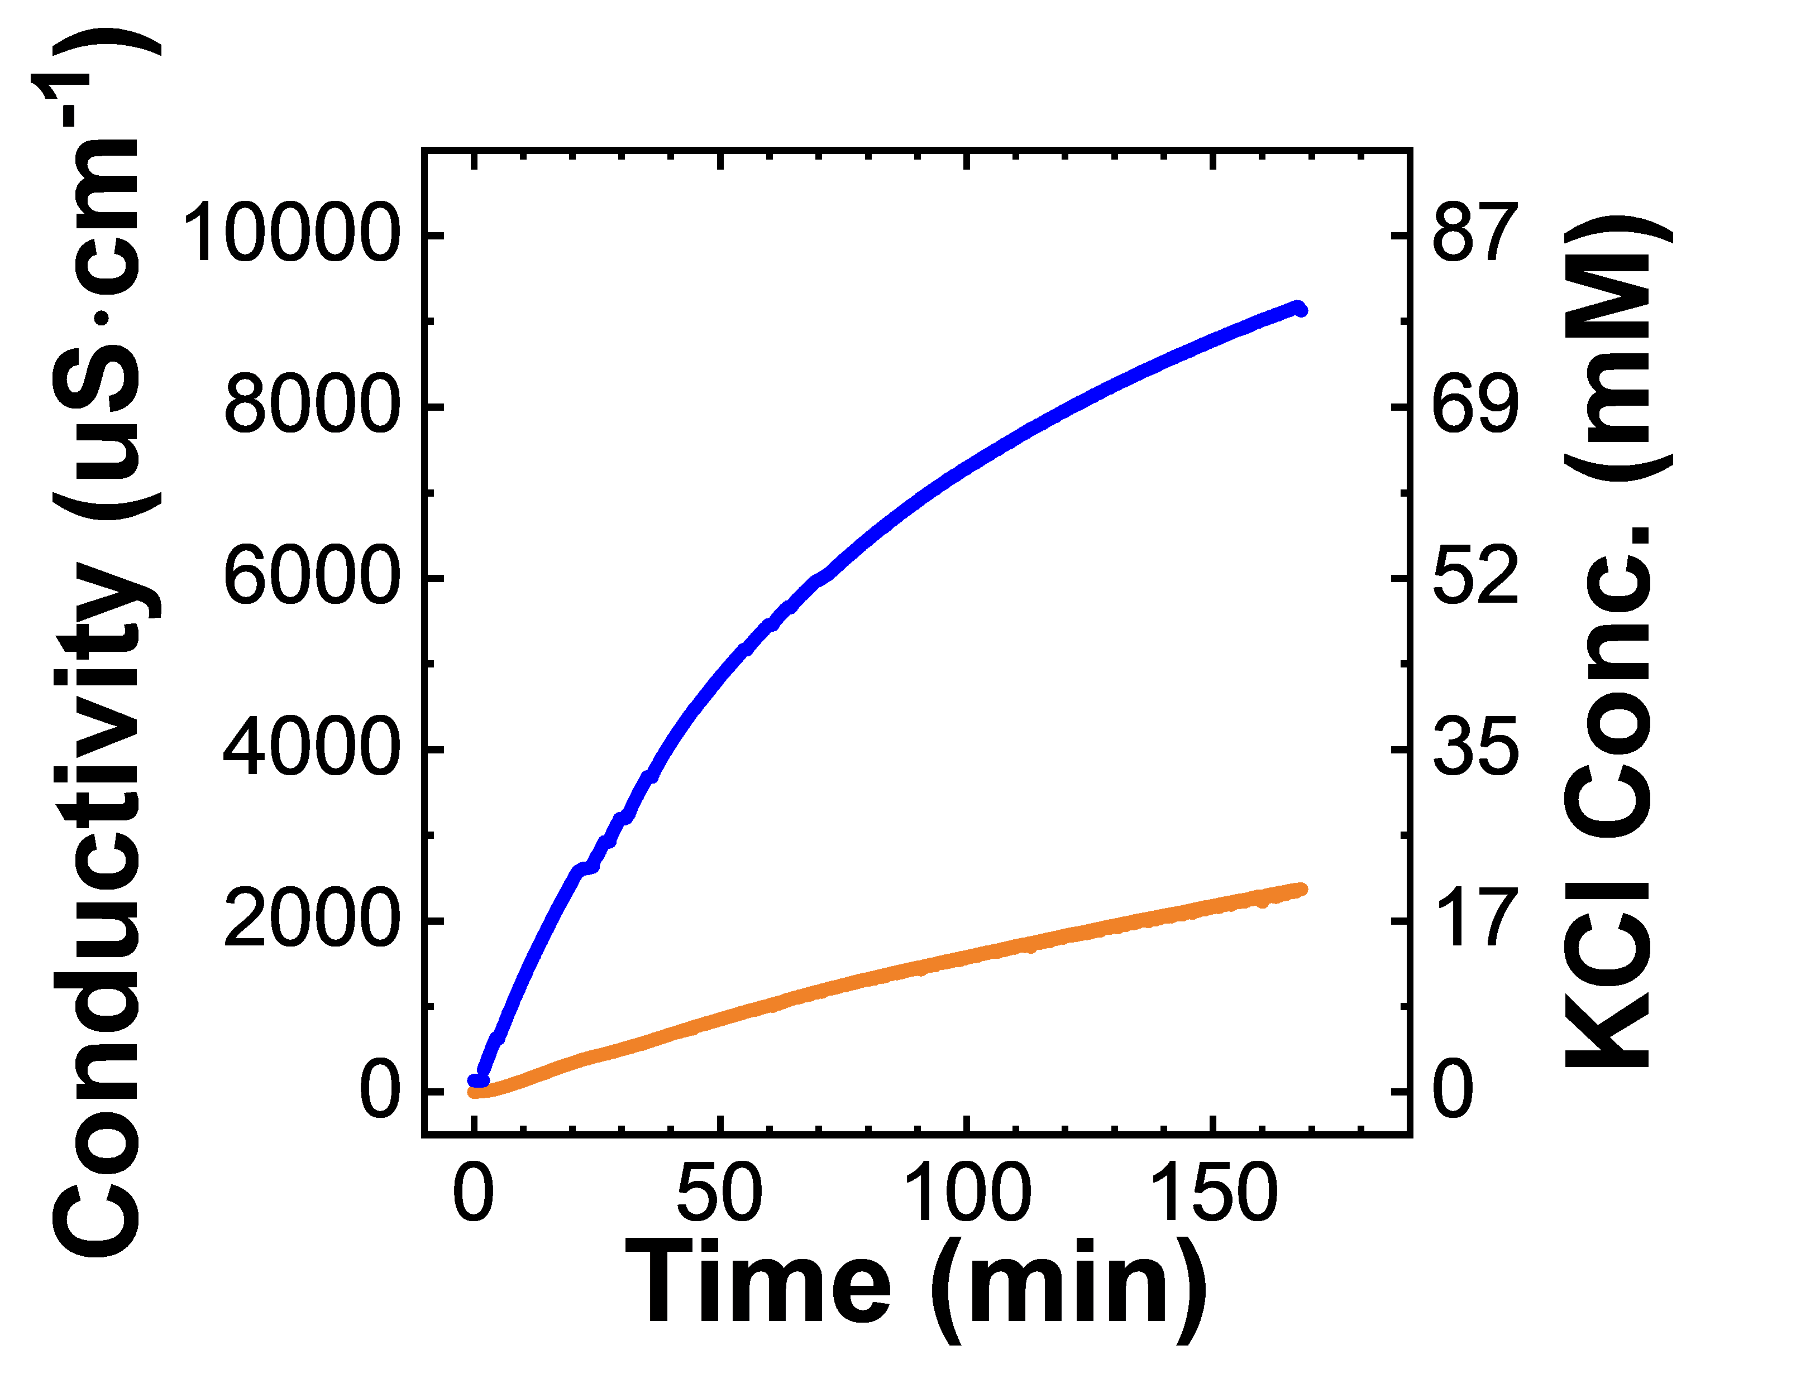
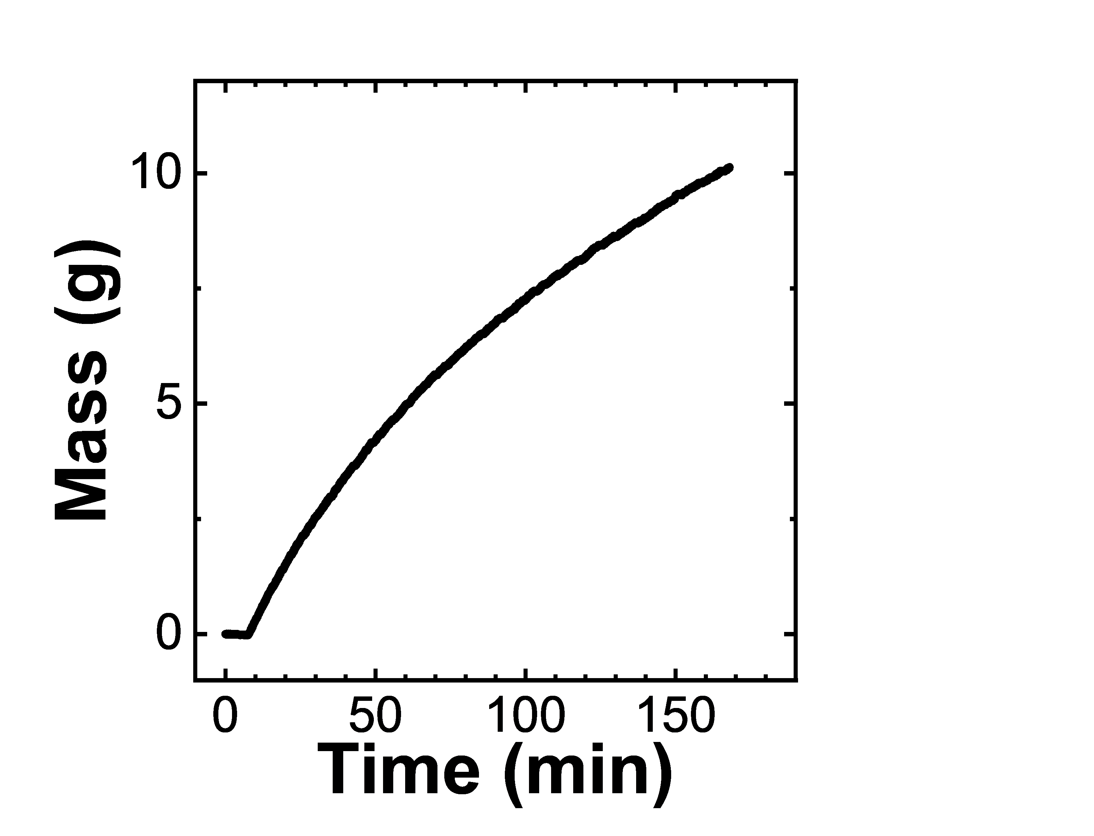
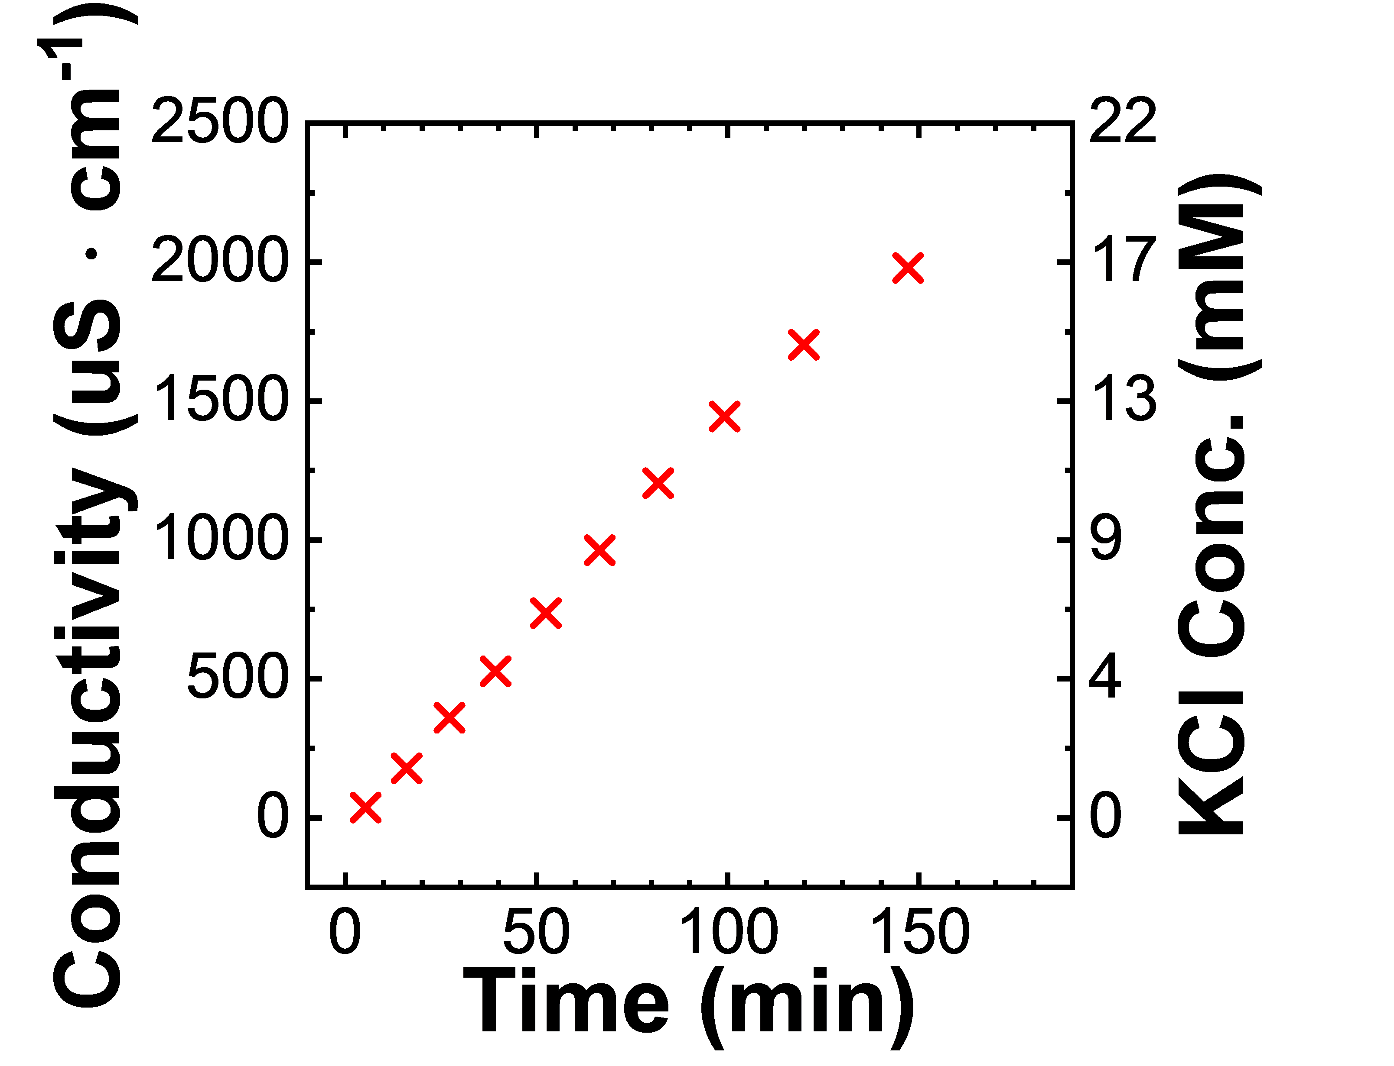
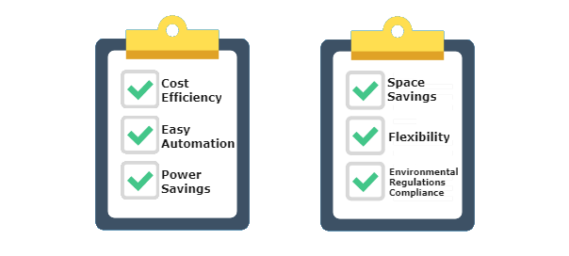
Separation using a Dynamic Diafiltration Device
Pressure Relief Valve
P
Pressure Gauge
Stirred Cell
Scintillation Vials
Diafiltrate Tank
Permeate Outlet
Motor
Retentate Probe
Balance
Membrane
Permeate Probe

Slide 9
Pressure Relief Valve
P
Pressure Gauge
Stirred Cell
Scintillation Vials
Diafiltrate Tank
Permeate Outlet
Motor
Retentate Probe
Balance
Membrane
Permeate Probe

Slide 10
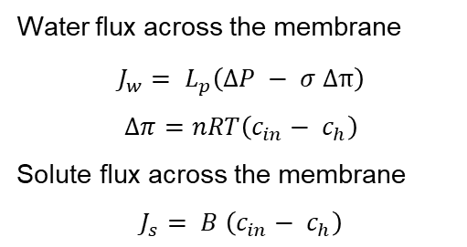
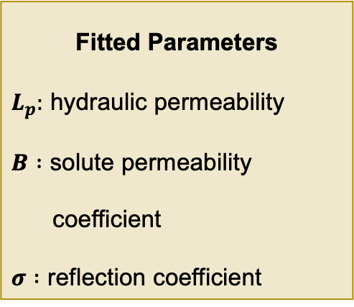
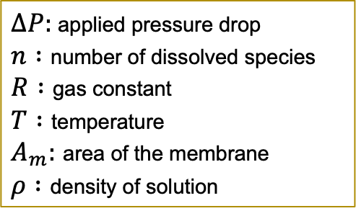
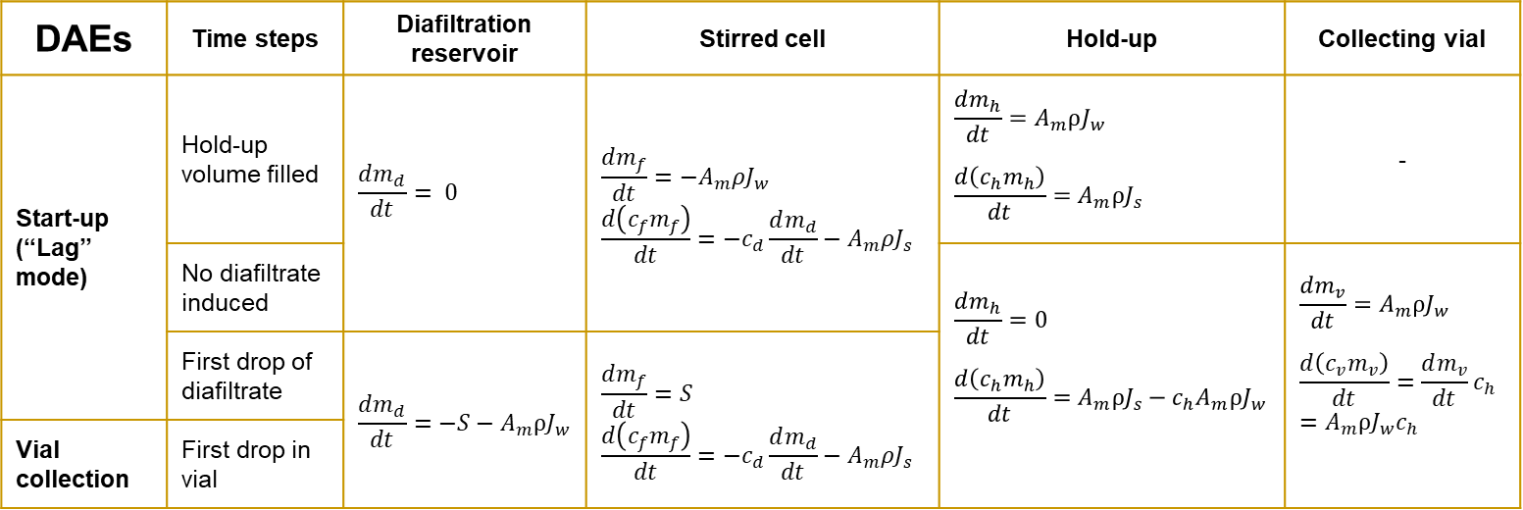
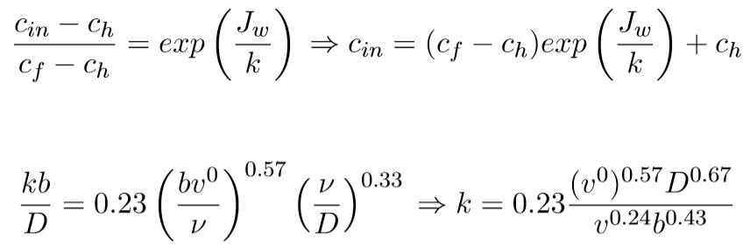
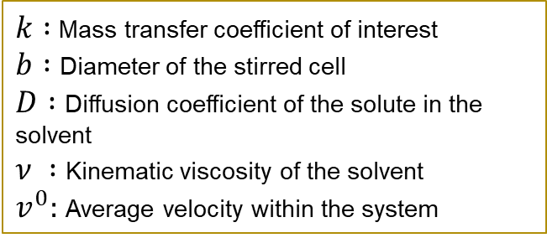
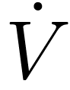
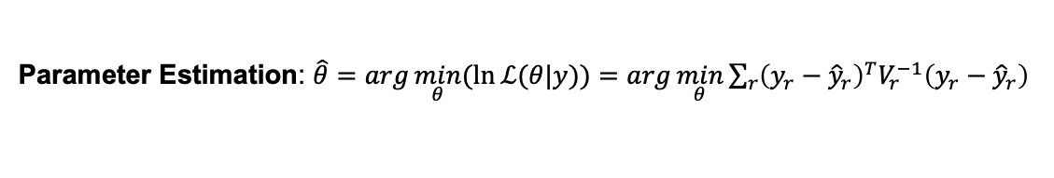
Dynamic Model w/ Lumped Parameter Infers Membrane Properties
Concentration
polarization
Parameter Estimation: $\hat{θ}=\arg{\min_{θ}{(\ln{ℒ(θ|y)})}}=\arg{\min_{θ}{\sum_{r}{{\left(y_{r}−{\hat{y}}_{r}\right)}^{T}V_{r}^{−1}\left(y_{r}−{\hat{y}}_{r}\right)}}}$

Slide 11
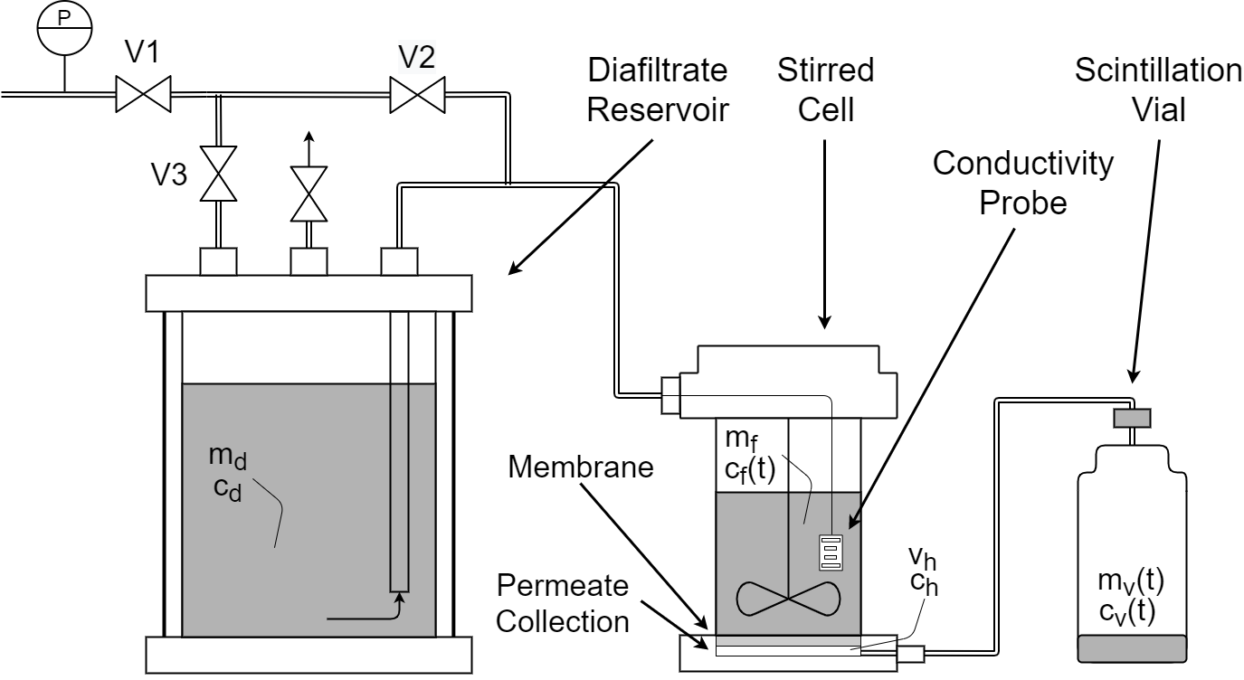
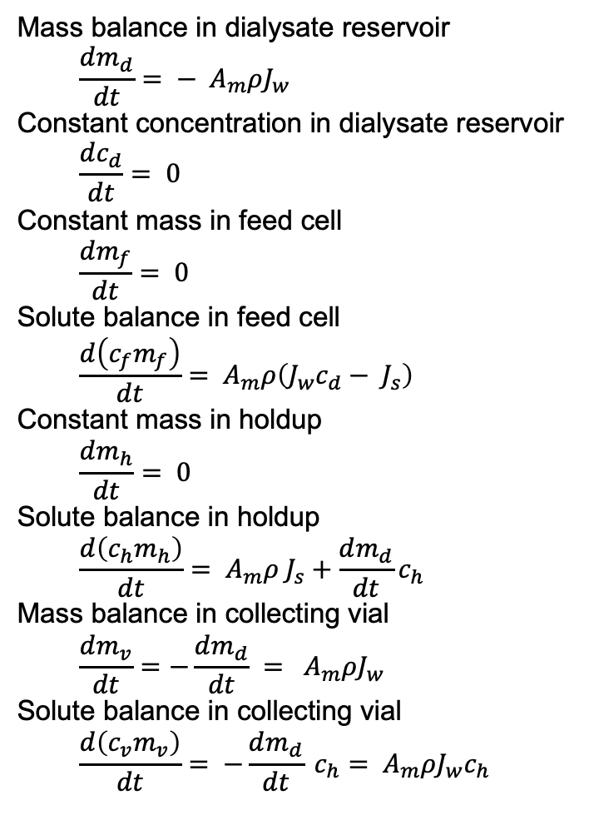
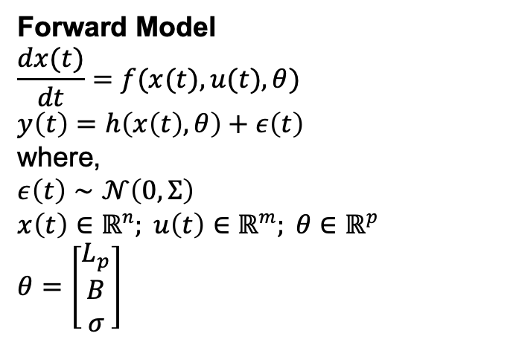
Lumped Parameter Model Infers Membrane Properties
Forward Model
$$\frac{dx(t)}{dt}=f(x(t),u(t),θ)$$ $y\left(t\right)=h\left(x\left(t\right),θ\right)+ε\left(t\right)$
where, $$ε\left(t\right)∼𝒩\left(0,Σ\right) \\ x\left(t\right)∈ℝ^{n}; u\left(t\right)∈ℝ^{m}; θ∈ℝ^{p}$$
$$θ=\left[\begin{aligned}L_{p} \\ B \\ σ\end{aligned}\right]$$
Concentration polarization
[Fig.] Ouimet, J. A. et. al., (2022). Journal of Membrane Science, 641, 119743.
Notes:
model parameters, hydraulic permeability Lp, solute permeability coefficient B that correspond to the membrane transport properties,
and reflection coefficient sigma that depends on the thermodynamics of the membrane-solution interface.

Slide 12
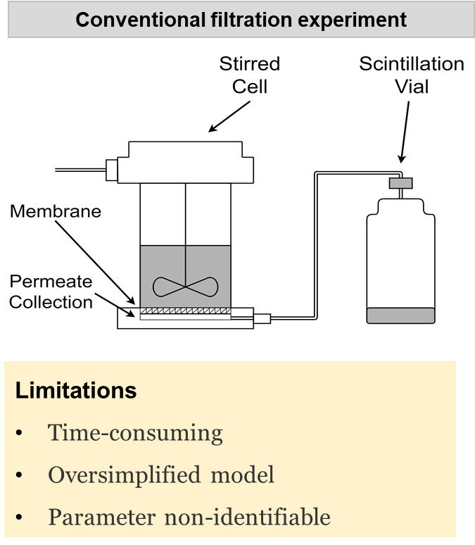
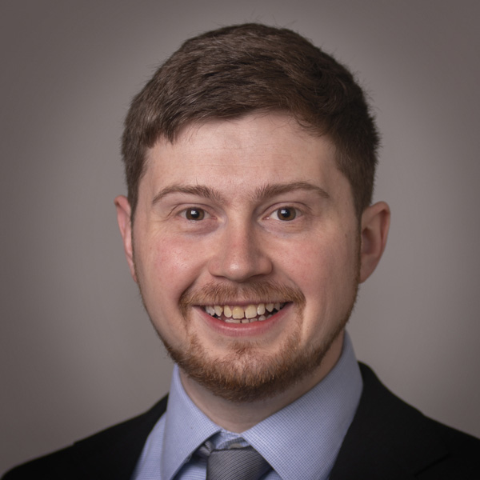
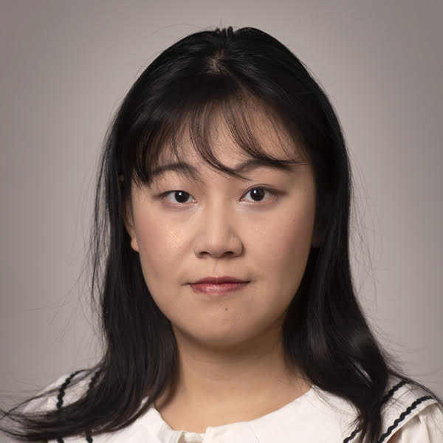
DATA: Diafiltration Apparatus for high-Throughput Analysis
William Phillip
Jonathan Ouimet
Alexander Dowling
Xinhong Liu
How model-based data analytics help improve membrane characterization?
[Fig.] Ouimet, J. A. et. al., (2022). Journal of Membrane Science.

Slide 13
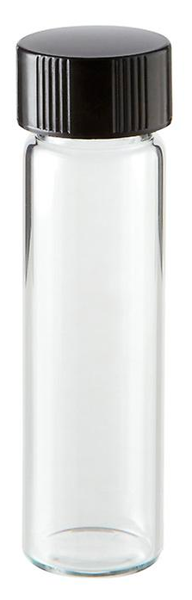
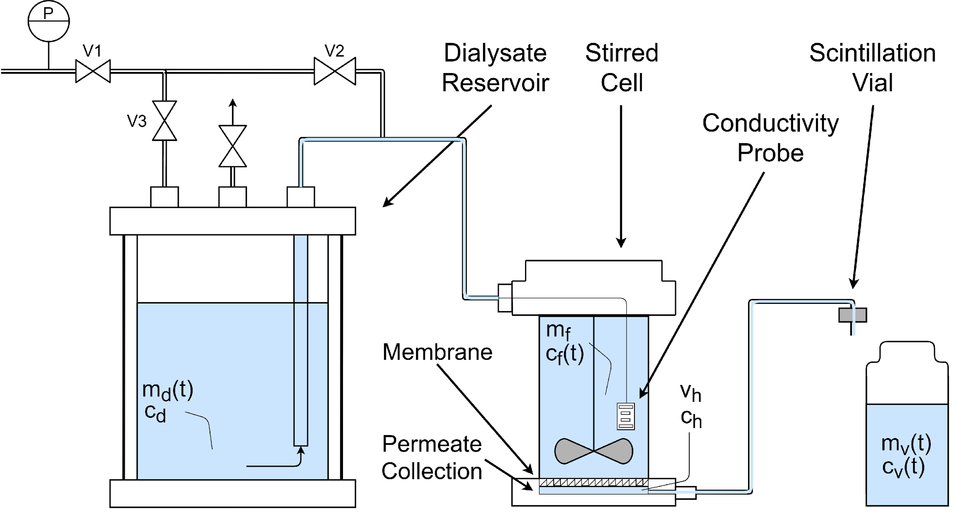
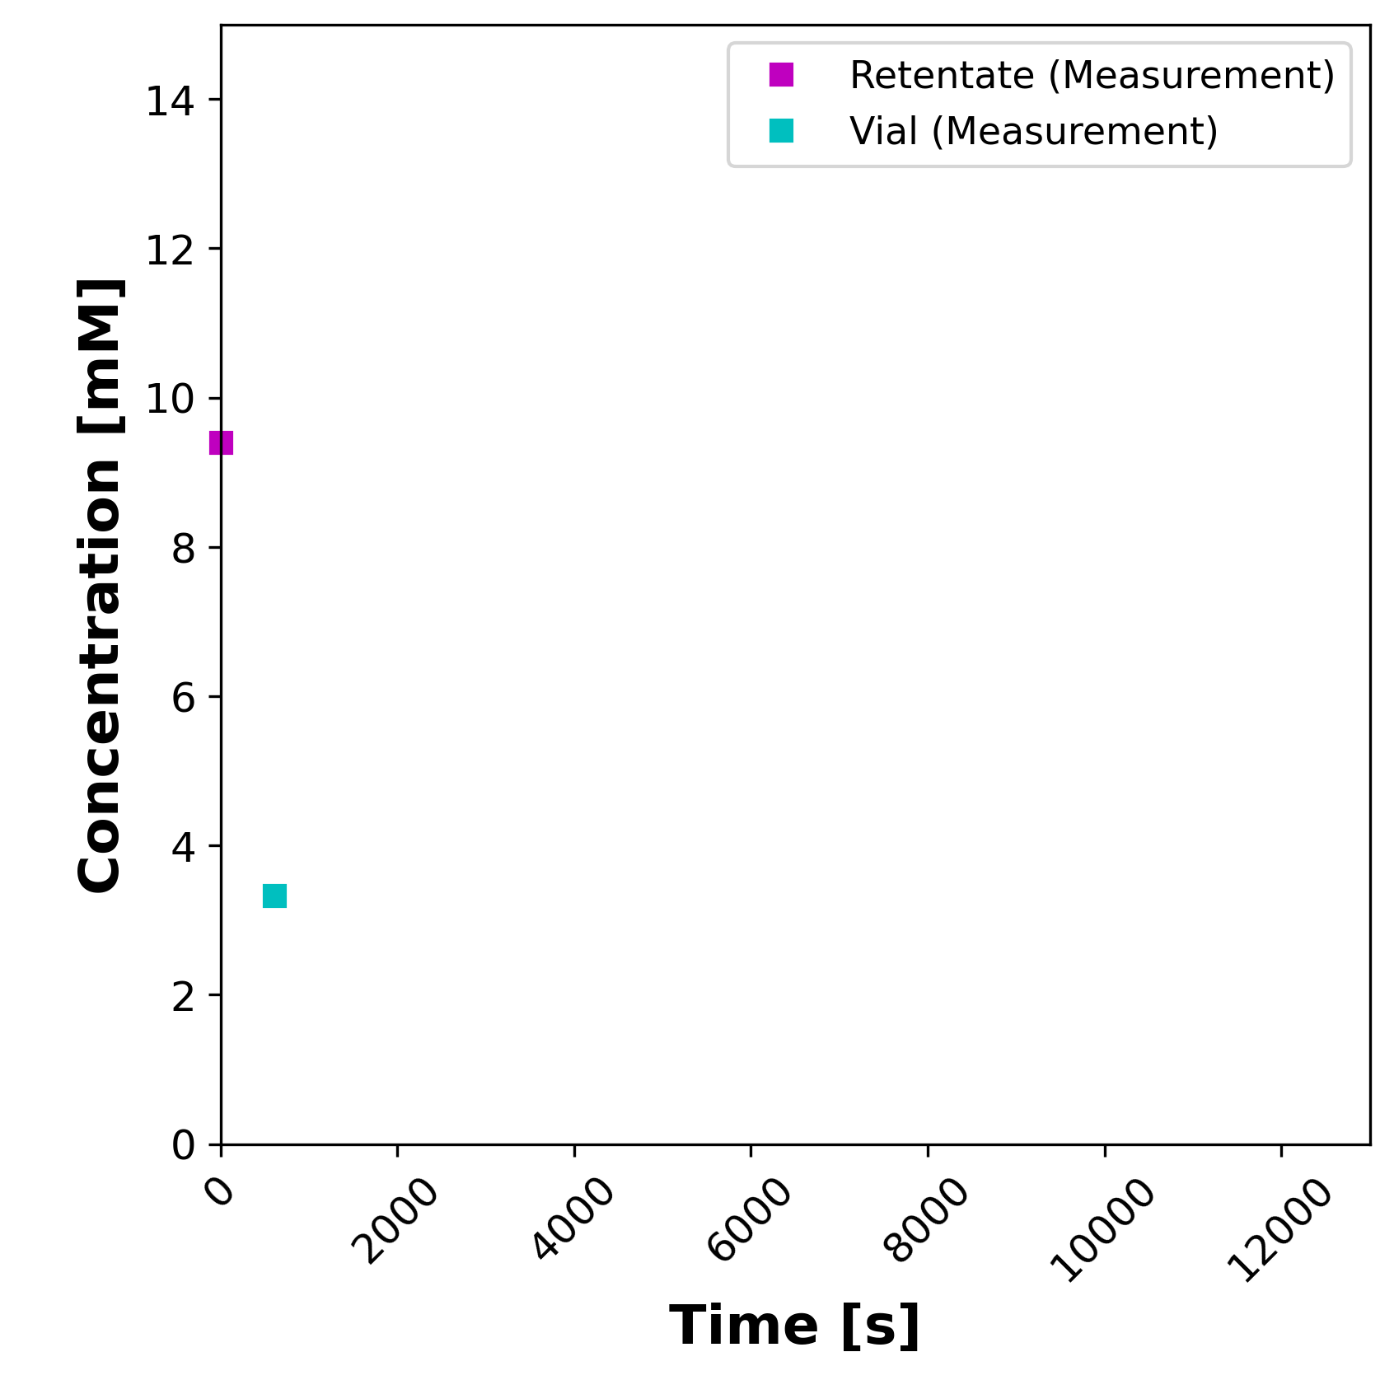
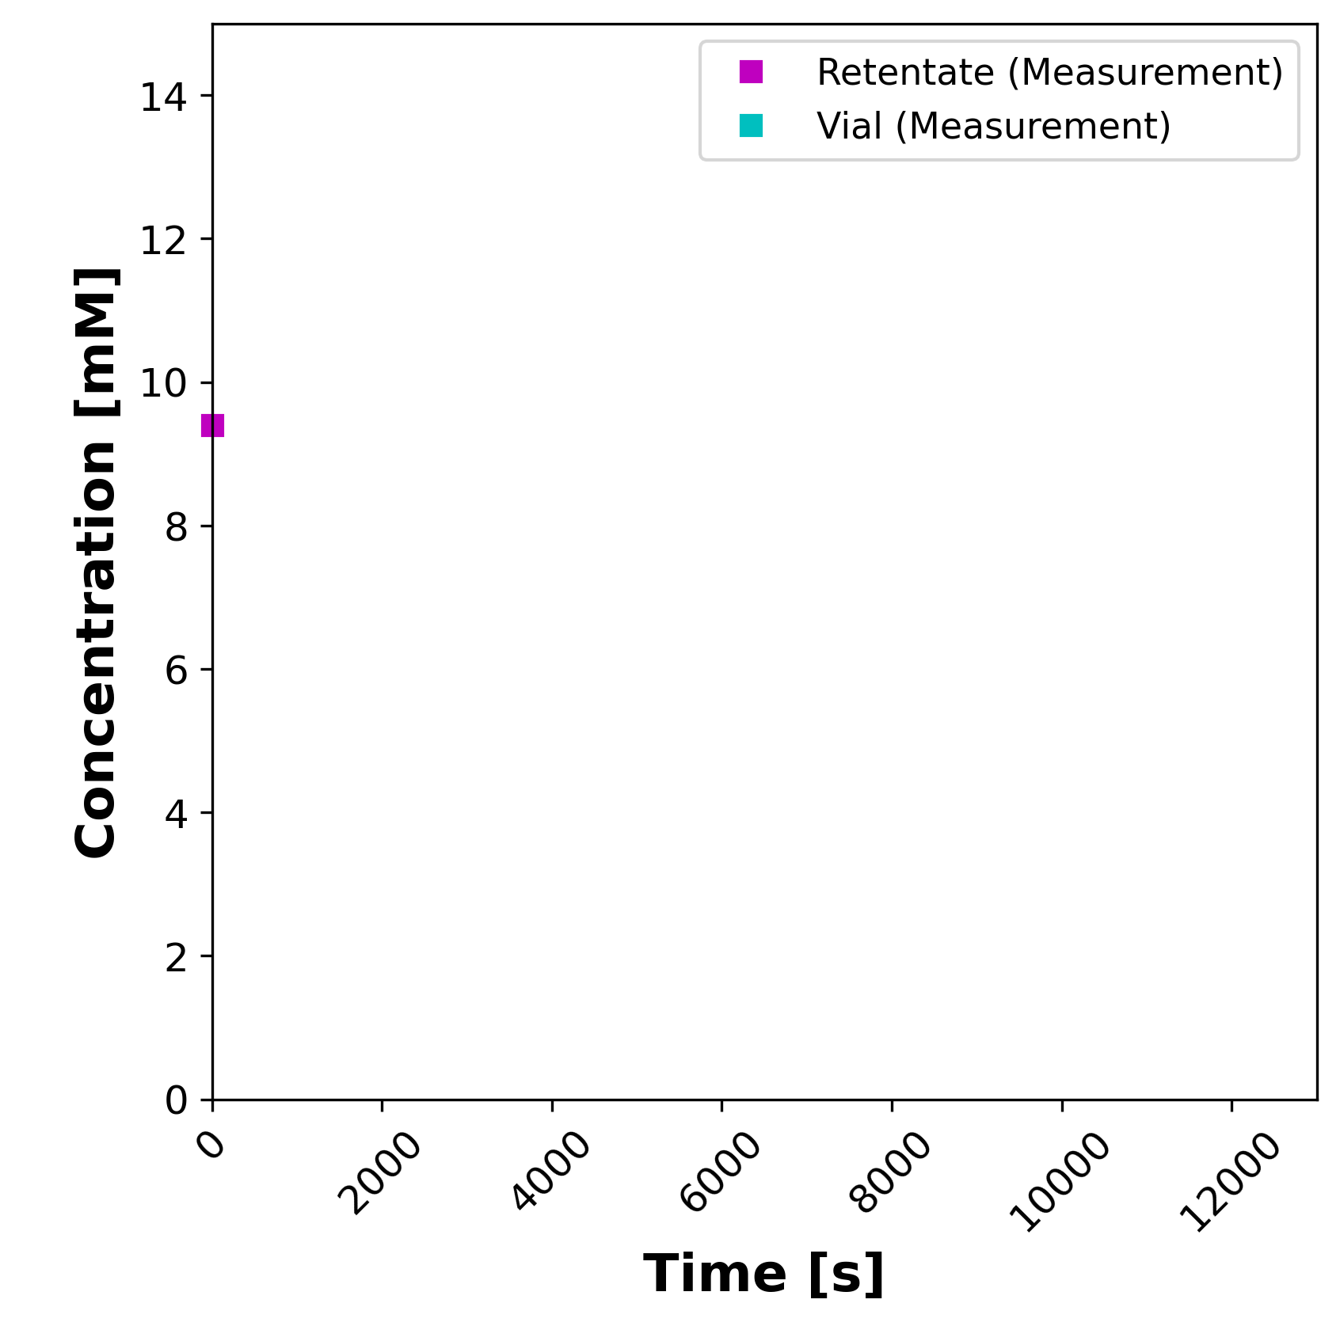
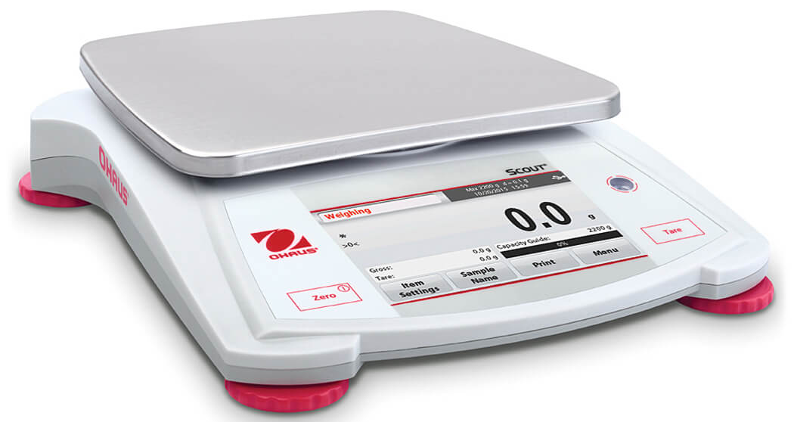
Dynamic Diafiltration Experiment Sweeps Larger Concentration Space
1
Experimental degrees of freedom: temperature, pressure, feed concentration, diafiltration concentration
Diafiltrate Reservoir

Slide 14
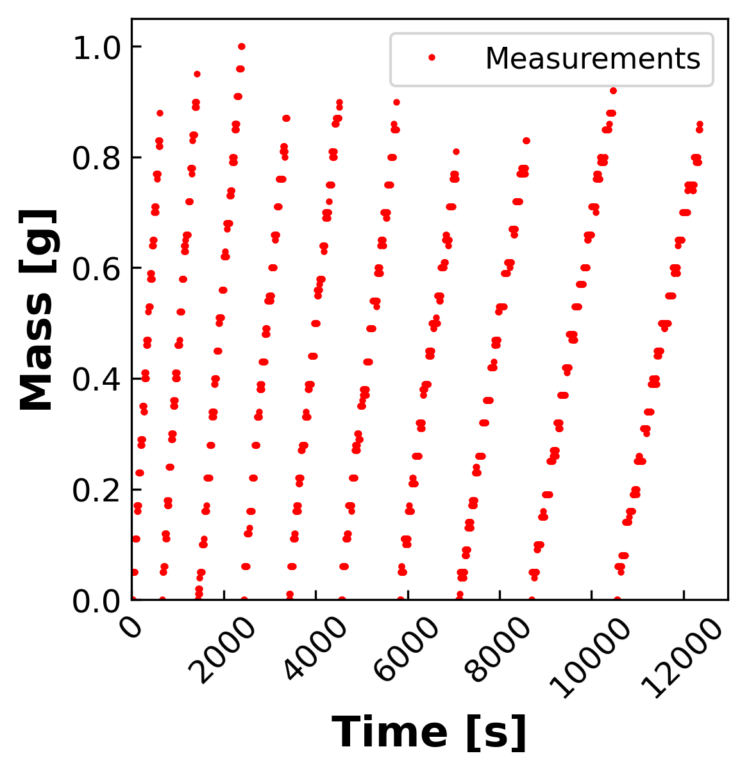
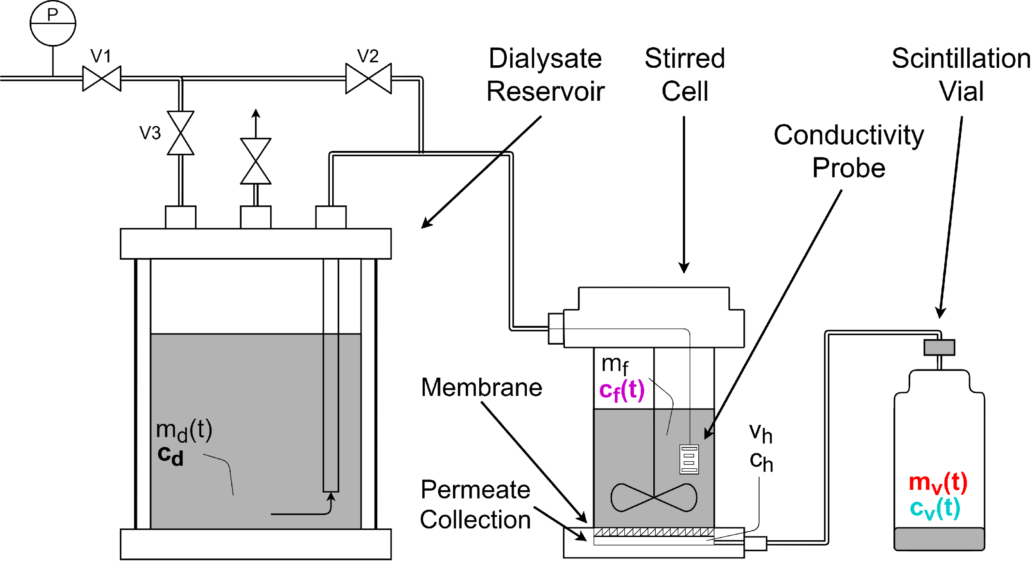
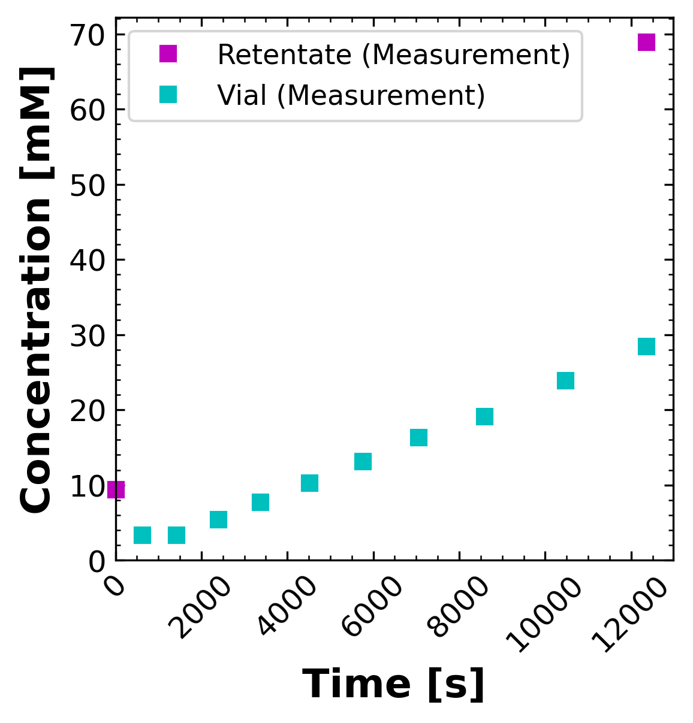
Dynamic Diafiltration Experiment Sweeps Larger Concentration Space 5x Faster Than Filtration Experiments
Diafiltrate Reservoir

Slide 15
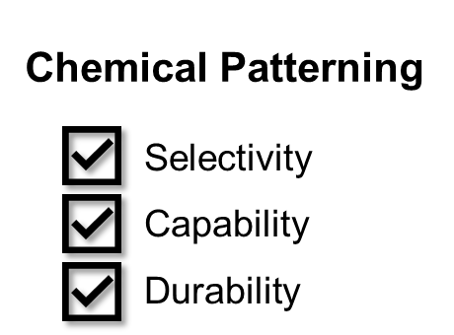
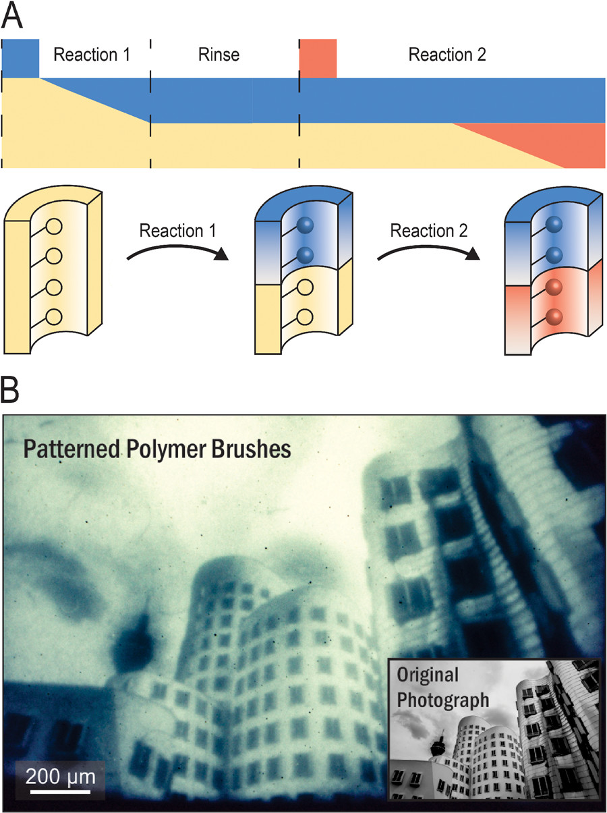
Fast Reaction is Preferred in Membrane Functionalization
Janus membranes
Reactive inks
Fast reaction creates clear boundary and enables precise chemical patterning.
[Top, Mid. Fig.] Hoffman, J. R., & Phillip, W. A. (2020). ACS Macro Letters, 9(9), 1267-1279.

Slide 16
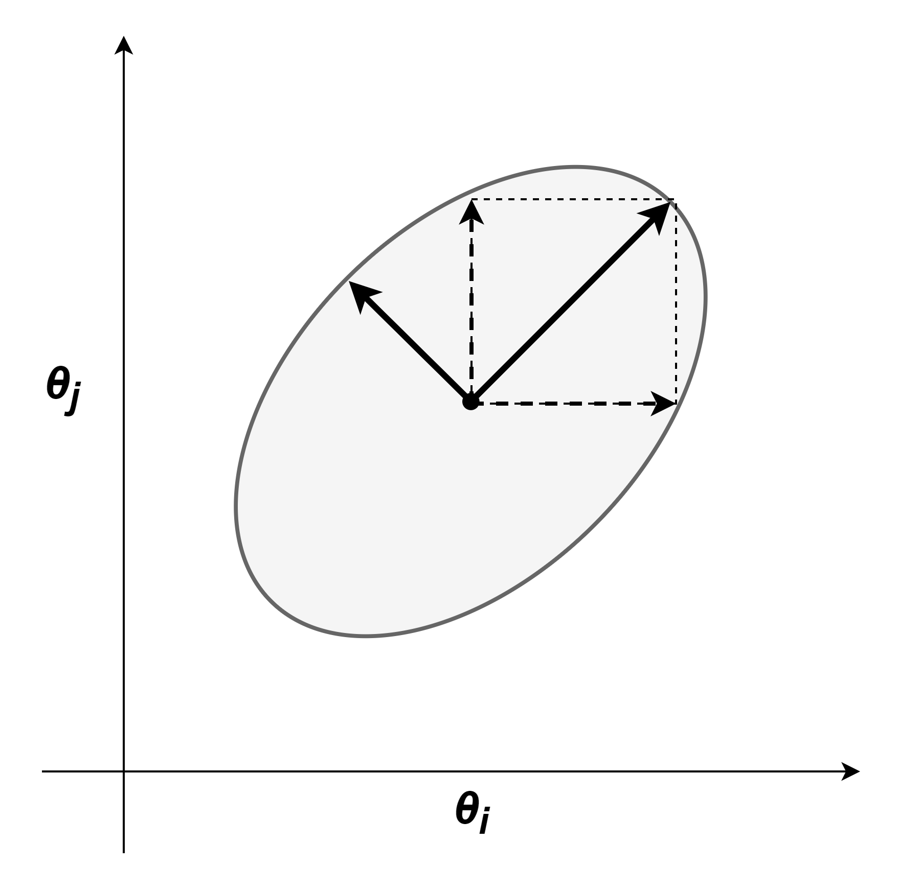

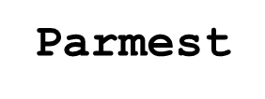
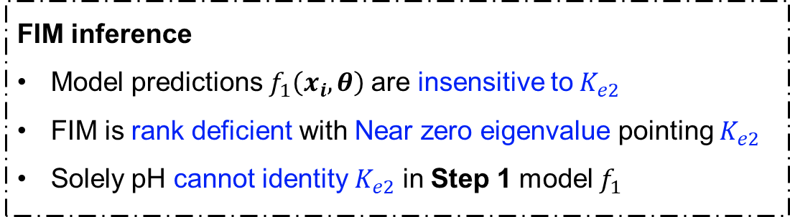
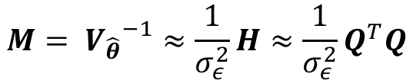
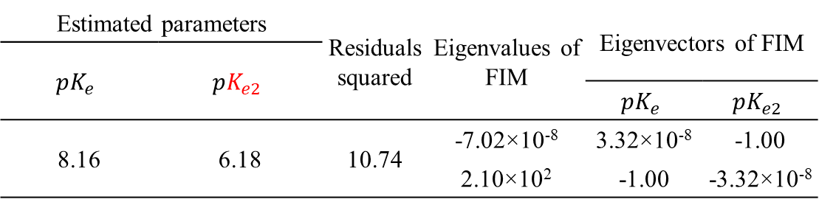

FIM Highlights Nonidentifiable Parameters
Fisher information matrix (FIM)
Estimated parameters |  | Residuals squared | Eigenvalues of FIM | Eigenvectors of FIM
$$pK_{e}$$ | $$pK_{e2}$$
 |  |  |  | $$pK_{e}$$ | $$pK_{e2}$$
8.16 | 6.18 | 10.74 | -7.02×10⁻⁸ | 3.32×10⁻⁸ | -1.00
 |  |  | 2.10×10² | -1.00 | -3.32×10⁻⁸
$$M= {V_{\hat{θ}}}^{−1}≈\frac{1}{σ_{ε}^{2}}H≈\frac{1}{σ_{ε}^{2}}Q^{T}Q$$
Confidence ellipse for covariance matrix
$$V_{\hat{θ}}= M^{−1}$$
FIM inference
Model predictions $f_{1}\left(x_{i},θ\right)$are insensitive to$K_{e2}$
FIM is rank deficient with Near zero eigenvalue pointing $K_{e2}$
Solely pH cannot identity $K_{e2}$ in Step 1 model $f_{1}$

Slide 17


